Slide 1
DevSecOps
Training

Slide 2
Agenda
https://docs.google.com/document/d/1Cydl3Eelcl1fEn4Epo7Ww7MBHmeIU3oC/edit

Slide 3
Training Format
Concepts
Hands-on exercises
Assignments
Interactive

Slide 4
Timing
Start time at 10 am
Break 11.30 am
Lunch 1pm to 2pm
Break 3.40
End at 6 pm

Slide 5
Terraform Overview
Declarative infrastructure language (HCL)
Multi-cloud support
Manages full resource lifecycle
State-driven infrastructure

Slide 6
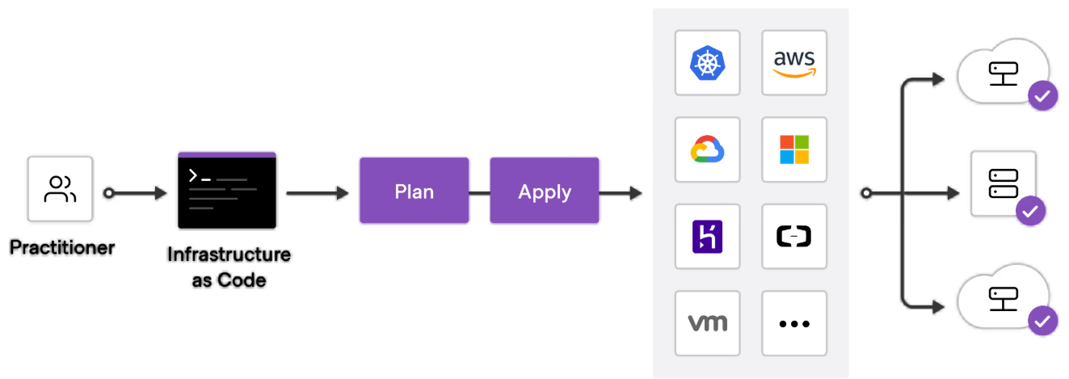
Terraform Overview

Slide 7
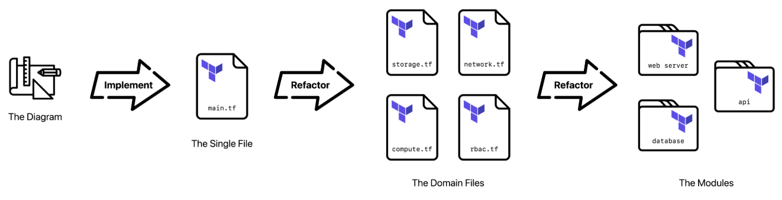
Terraform Core Concepts
Providers connect to cloud platforms
Resources define infrastructure
Modules enable reuse
State tracks real infrastructure
Plan previews changes

Slide 8
Terraform Core Concepts

Slide 9
Exercise
arjunachari12/terraform-devsecops

Slide 10
Azure
Account creation

Slide 11
Azure Security Fundamentals
Azure security follows an identity-first approach
Zero Trust is the default security model
Security is shared between Microsoft and customer
Defense-in-depth across all layers
Security is built into Azure platform services
Most cloud breaches are due to misconfiguration
Security must be enforced by design, not reaction

Slide 12
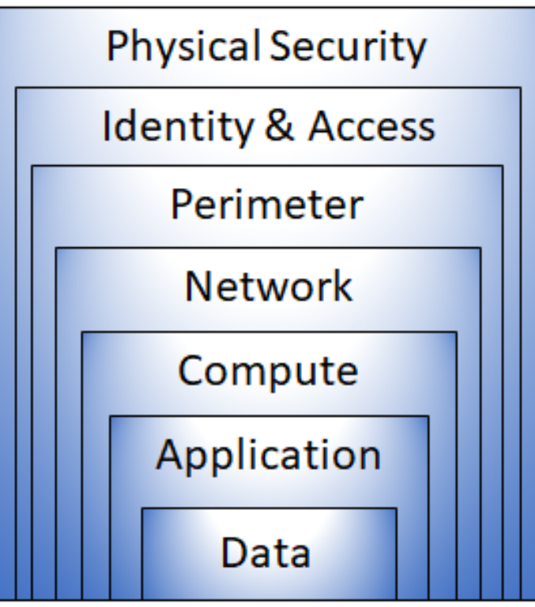
Shared Responsibility Model
Microsoft secures physical datacenters
Microsoft secures Azure fabric and host OS
Customer secures identity and access
Customer secures data and configurations
Responsibility varies by IaaS, PaaS, SaaS
Misunderstanding this causes security gaps
Always clarify ownership per service

Slide 13
Defense in Depth
Multiple security layers reduce attack success
Identity layer is the first line of defense
Network segmentation limits blast radius
Compute hardening reduces vulnerabilities
Data encryption protects sensitive information
Monitoring enables detection and response
No single control is sufficient alone

Slide 14
Identity is the New Perimeter
Traditional network perimeter no longer sufficient
Users access from anywhere, any device
Identity becomes the primary control plane
Strong authentication is mandatory
Least privilege reduces misuse risk
Continuous verification required
Zero Trust relies on identity signals

Slide 15
Microsoft Entra ID
Central identity and authentication service
Controls access to Azure and Microsoft services
Primary target for attackers
Supports MFA and Conditional Access
Integrates with on-prem Active Directory
Tenant compromise equals full environment risk
Foundation for Zero Trust architecture

Slide 16
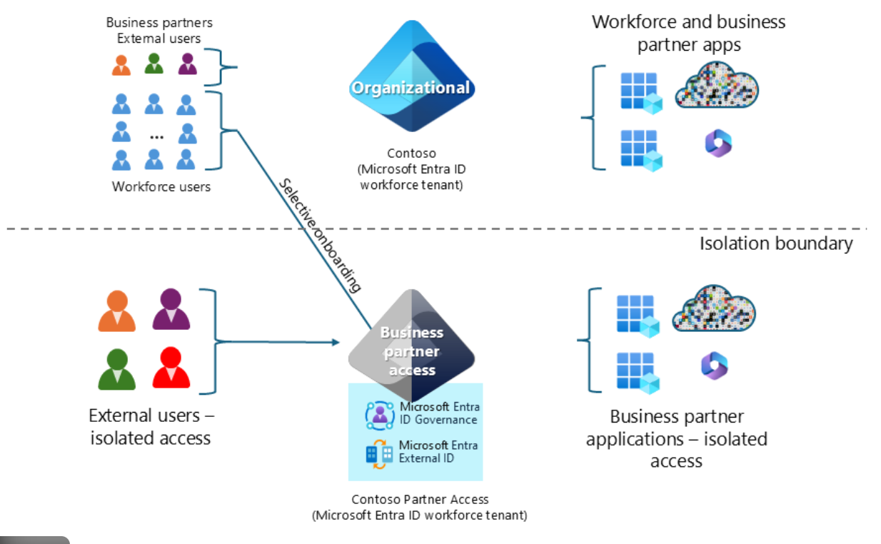
Microsoft Entra ID

Slide 17
Conditional Access
Policy-based access decision engine
Evaluates user, device, location, risk
Enforces MFA dynamically
Blocks risky or non-compliant access
Disables legacy authentication
Reduces token abuse and credential attacks
Core Zero Trust security control

Slide 18
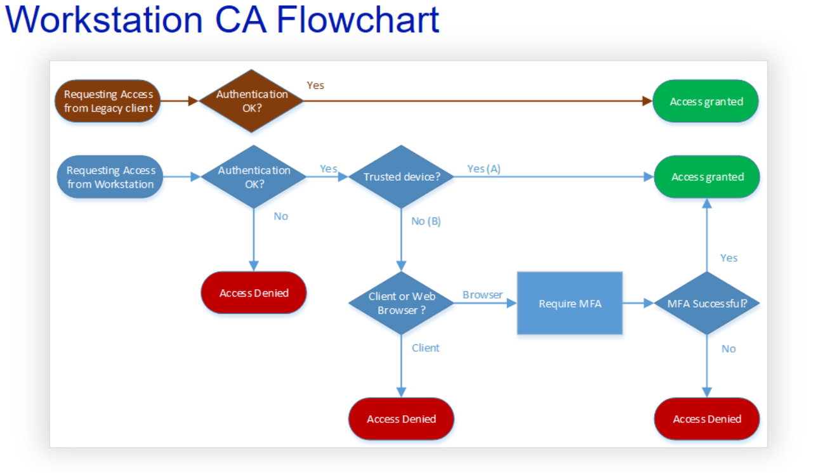
Conditional Access

Slide 19
Privileged Identity Management (PIM)
Eliminates standing admin access
Provides just-in-time role activation
Requires MFA for elevation
Access is time-bound
Approval workflows supported
Reduces blast radius of compromise
Mandatory for enterprise tenants

Slide 20
Azure RBAC
Defines who can do what on resources
Authorization model for Azure
Scopes include MG, Subscription, RG, Resource
Least privilege principle is critical
Over-privileged roles are common risk
Prefer group-based role assignments
Auditable and policy-driven

Slide 21
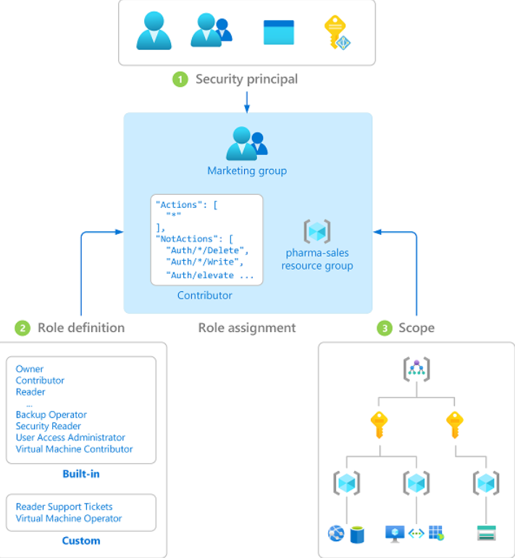
Azure RBAC

Slide 22
Network Security Overview
Network is second major security layer
VNets provide isolation boundary
Segmentation limits lateral movement
Default deny inbound traffic recommended
Private connectivity preferred
Flat networks increase attack surface
Foundation for secure architecture

Slide 23
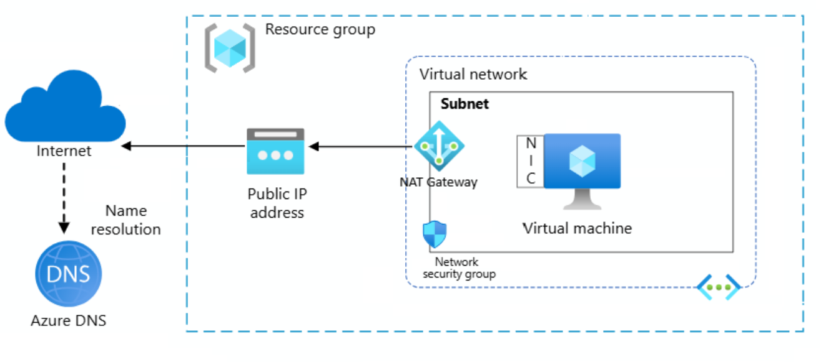
Network Security Overview

Slide 24
Virtual Networks (VNet)
Private IP address space
Isolation boundary in Azure
Supports subnet segmentation
Controls routing and connectivity
Enables private service access
Required for secure workloads
Base for hybrid connectivity

Slide 25
Network Security Groups (NSG)
Stateful L3/L4 traffic filtering
Applied at subnet or NIC level
Default deny inbound traffic
Controls east-west traffic
Misconfiguration is common risk
Supports service tags
Basic but essential security control

Slide 26
Azure Firewall
Managed cloud-native firewall
Centralized ingress and egress control
Supports application and network rules
Threat intelligence integration
Prevents data exfiltration
Logs all traffic centrally
Critical for enterprise networks

Slide 27
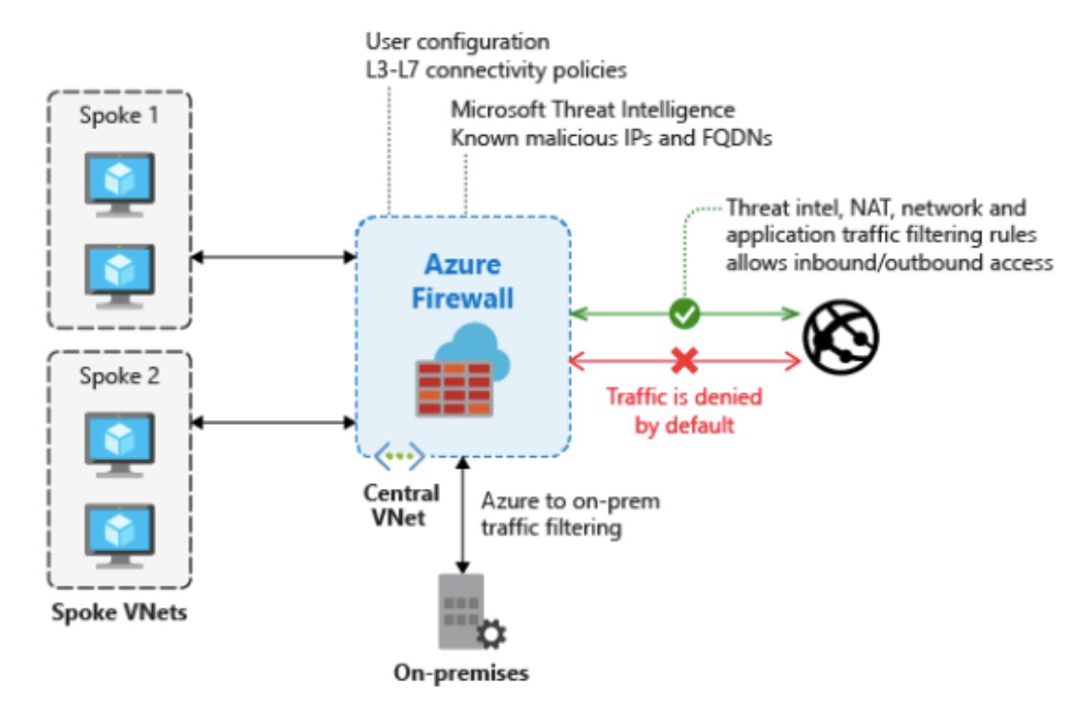
Azure Firewall

Slide 28
Web Application Firewall (WAF)
Layer 7 HTTP/HTTPS protection
Defends against OWASP Top 10
Protects web applications
Integrated with App Gateway and Front Door
Blocks injection and scripting attacks
Reduces application-layer risk
Required for internet-facing apps

Slide 29
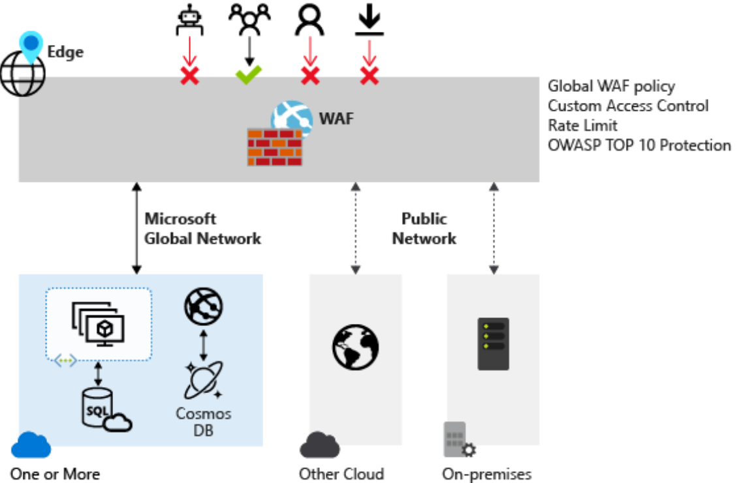
Web Application Firewall (WAF)

Slide 30
Azure DDoS Protection
Protects against volumetric attacks
Basic protection enabled by default
Standard tier for critical workloads
Ensures service availability
Absorbs large-scale attacks
Always-on monitoring
Protects public endpoints

Slide 31
Private Endpoints (Private Link)
Removes public internet exposure
Maps PaaS services to private IP
Critical for data protection
Prevents data exfiltration
Requires private DNS configuration
Strong Zero Trust control
Recommended for sensitive workloads

Slide 32
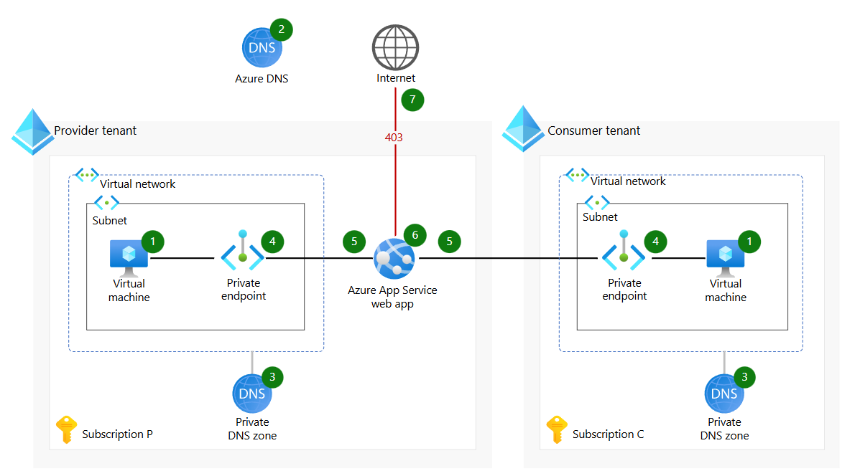
Private Endpoints (Private Link)

Slide 33
Encryption at Rest
Protects stored data
Enabled by default in most services
Supports Microsoft-managed keys
Customer-managed keys via Key Vault
Required for compliance
Protects against offline theft
Applies to disks, storage, databases

Slide 34
Encryption in Transit
Protects data during transmission
Uses TLS encryption
Prevents man-in-the-middle attacks
Mandatory for internet traffic
Private endpoints reduce exposure
Required for compliance
Applies to service-to-service traffic

Slide 35
Azure Key Vault
Central secrets and key management
Stores secrets, keys, certificates
Integrates with Managed Identity
Supports HSM-backed keys
Enables key rotation
Audit logging for access
Prevents secrets in code

Slide 36
Microsoft Defender for Cloud
Cloud Security Posture Management
Detects misconfigurations
Provides secure score
Workload protection features
Compliance tracking
Actionable recommendations
Central security dashboard

Slide 37
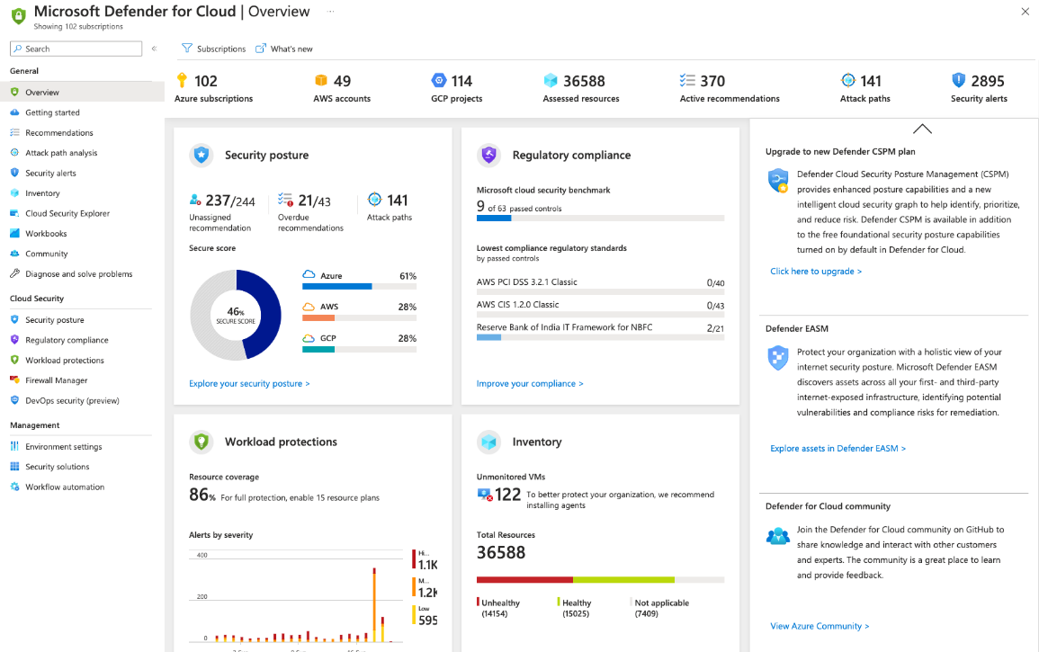
Microsoft Defender for Cloud

Slide 38
Microsoft Sentinel
Cloud-native SIEM and SOAR
Centralized log analytics
Detects advanced threats
Uses KQL for threat hunting
Automates incident response
Integrates with Azure services
SOC visibility platform

Slide 39
Azure Policy
Policy-as-code enforcement
Prevents insecure deployments
Supports deny and audit effects
Enforces compliance standards
Scales across subscriptions
Reduces human error
Key governance control

Slide 40
Azure Security Baselines
Predefined security best practices
Service-specific guidance
Aligned to compliance frameworks
Secure-by-default configurations
Reduces design decisions
Prevents common misconfigurations
Foundation for enterprise security

Slide 41
DevSecOps in Azure
Shift-left security approach
IaC security scanning
Secrets scanning in pipelines
OIDC-based authentication
Policy enforcement in CI/CD
Automated compliance checks
Reduces deployment risk

Slide 42
Common Azure Security Mistakes
No MFA on administrators
Over-privileged RBAC roles
Public storage exposure
Flat network architecture
Secrets stored in code
No logging enabled
Reactive security approach

Slide 43
Zero Trust in Azure
Never trust, always verify
Identity-centric security model
Least privilege access
Assume breach mindset
Continuous monitoring
Applies across all services
Modern security standard

Slide 44
Key Takeaways
Identity is the new perimeter
Prevent misconfigurations first
Private access over public
Security must be automated
Logs are non-negotiable
Defense-in-depth is required
Design secure by default

Slide 45
AWS Shared Responsibility Model
AWS secures physical data centers
Customer secures workloads and data
Responsibility differs by service type
Misunderstanding causes security gaps
Foundation of AWS security
Comparable to Azure model

Slide 46
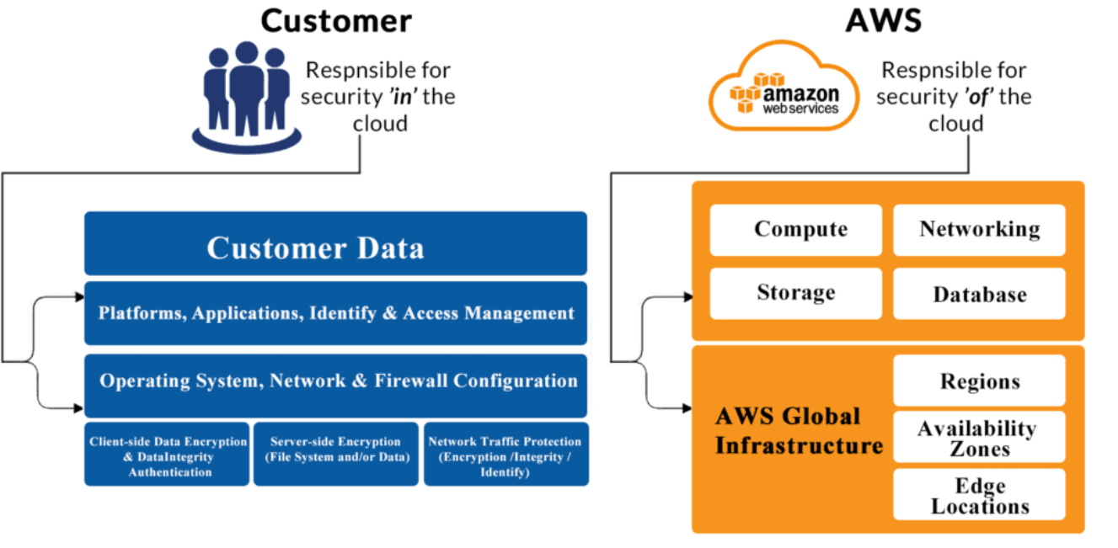
AWS Shared Responsibility Model

Slide 47
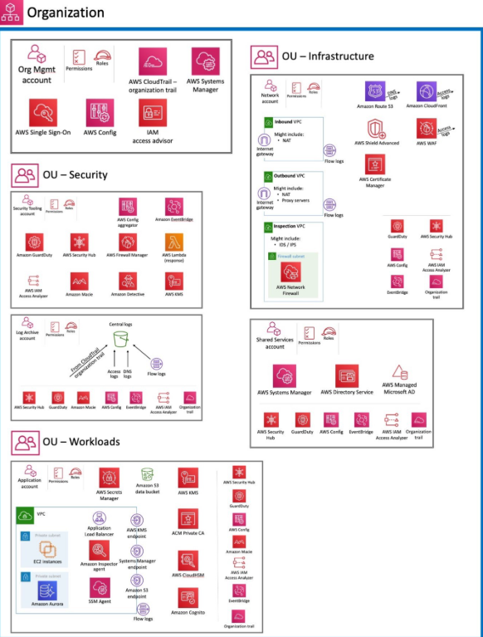
AWS Shared Responsibility Model

Slide 48
AWS Identity & Access Management (IAM)
Core identity and authorization service
Policies define allowed actions
IAM users, roles, and policies
IAM misconfiguration is top risk
Least privilege required
Comparable to Entra ID + RBAC

Slide 49
IAM Roles & Temporary Credentials
Short-lived credentials via STS
Preferred over access keys
Secure service-to-service access
Supports cross-account access
Reduces credential leakage
Similar to Managed Identity

Slide 50
AWS Organizations & SCPs
Manages multiple AWS accounts
SCPs enforce security guardrails
Prevents high-risk actions
Reduces blast radius
Enterprise security foundation
Similar to Azure MG + Policy

Slide 51
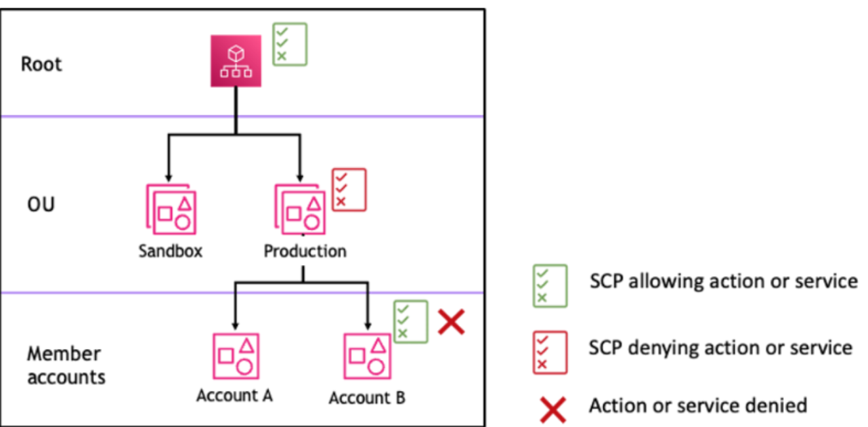
AWS Organizations & SCPs

Slide 52
Amazon VPC – Network Isolation
Isolated virtual network
Controls IP ranges and routing
Public and private subnets
Segmentation limits lateral movement
Foundation of network security
Similar to Azure VNet

Slide 53
Security Groups & NACLs
Security Groups are stateful firewalls
NACLs are stateless subnet filters
Default deny inbound traffic
Common source of exposure
Defense in depth
Similar to NSGs

Slide 54
Network & Application Protection
AWS Network Firewall for inspection
AWS WAF protects web apps
AWS Shield for DDoS protection
Protects availability and perimeter
Critical for public workloads
Comparable Azure services exist

Slide 55
Encryption & Key Management
Encryption at rest and in transit
AWS KMS manages keys
Customer-managed keys supported
Critical for compliance
Reduces data breach impact
Comparable to Key Vault

Slide 56
Threat Detection – GuardDuty
Managed threat detection
Analyzes logs and network traffic
Detects compromised accounts
No agents required
Easy to enable
Comparable to Defender signals

Slide 57
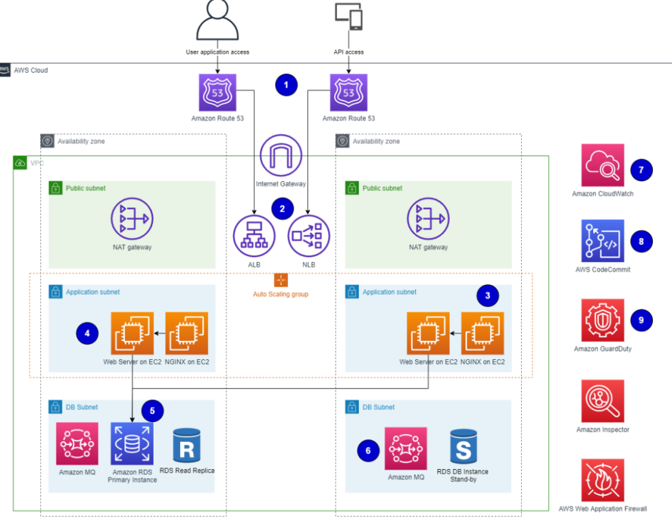
Threat Detection – GuardDuty

Slide 58
Security Posture – Security Hub
Central security dashboard
Aggregates findings
Maps to security standards
Improves visibility
Continuous compliance
Comparable to Defender for Cloud

Slide 59
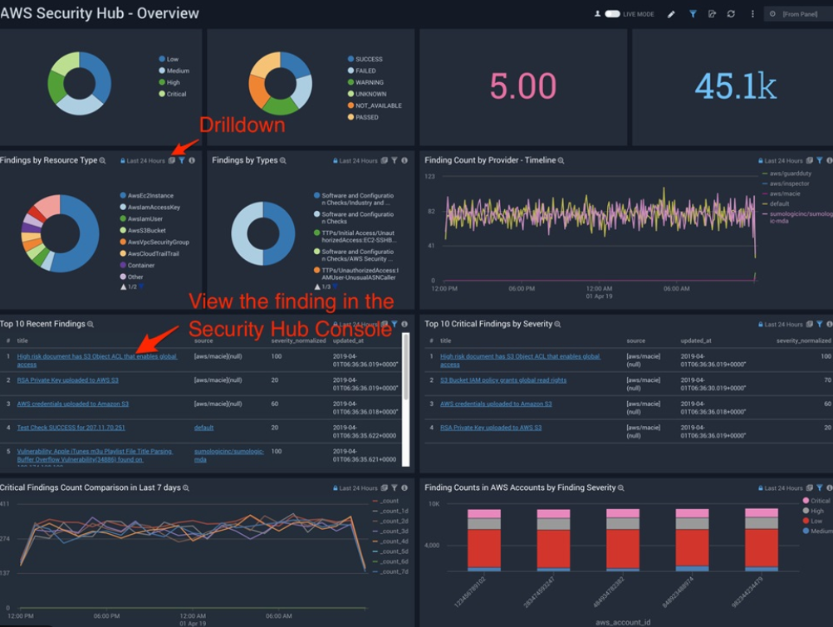
Security Posture – Security Hub

Slide 60
Logging & Monitoring
CloudTrail logs API activity
VPC Flow Logs capture traffic
Critical for investigations
Feeds SIEM tools
Must be enabled by default
Comparable to Azure logs

Slide 61
Compute & Container Security
Amazon Inspector scans vulnerabilities
Patch via Systems Manager
IAM roles for EC2/EKS
Image scanning
Misconfigurations are common
Comparable Azure protections

Slide 62
Zero Trust on AWS
Identity-first security model
Never trust network location
Least privilege everywhere
Continuous monitoring
Assume breach mindset
Same as Azure Zero Trust

Slide 63
Common AWS Security Mistakes
Overly permissive IAM policies
No MFA on root/admin
Public S3 buckets
Unused access keys
No logging enabled
Flat VPC designs

Slide 64
AWS Security – Key Takeaways
Understand shared responsibility
IAM is most critical
Prefer roles over keys
Encrypt and log everything
Use managed security services
Design secure by default

Slide 65
Checkov – What & Why
Open-source IaC security scanner
Developed by Bridgecrew (Palo Alto Networks)
Detects cloud misconfigurations early
Supports Terraform, ARM, CFN, Kubernetes
Ideal for shift-left security

Slide 66
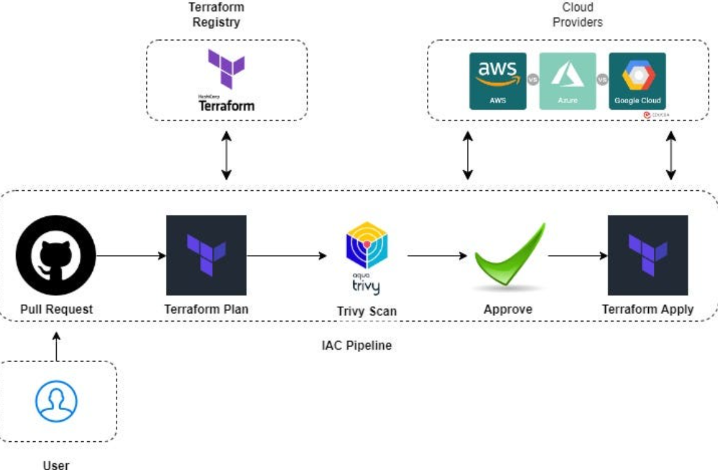
Checkov – What & Why

Slide 67
Checkov – Problems Solved
Public cloud resources
Missing encryption
Weak IAM policies
Open network access
Compliance violations

Slide 68
Checkov – How It Works
Parses IaC files
Applies built-in rules
Maps to standards (CIS, NIST)
Assigns severity levels
Produces fix guidance

Slide 69
Checkov – Hands-on Flow
Write Terraform code
Run Checkov scan
Review failed checks
Fix misconfigurations
Re-run pipeline

Slide 70
Checkov – When to Use
Early CI stage
Fast security feedback
No custom policy needed
First IaC security gate

Slide 71
Conftest – What & Why
Policy-as-Code tool
Built on Open Policy Agent
Validates configs & Terraform plans
Enforces org-specific rules
Flexible and lightweight

Slide 72
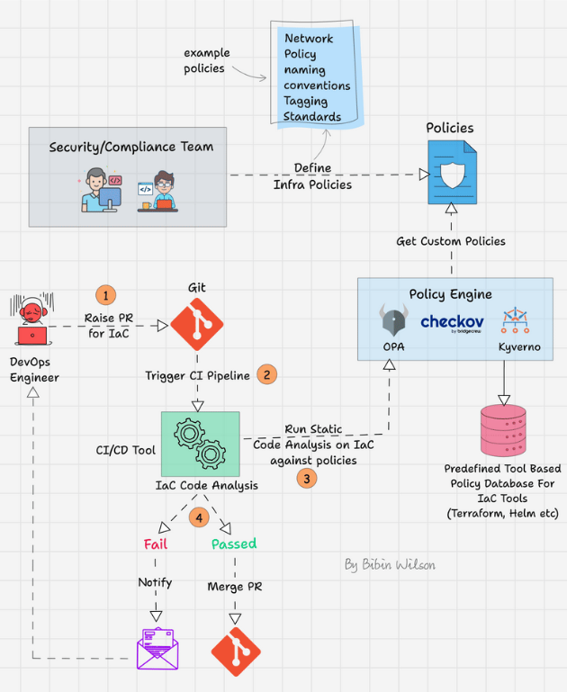
Conftest – What & Why

Slide 73
Conftest – Problems Solved
Custom security requirements
Tagging standards
Internal compliance rules
Beyond built-in scanners
Consistent enforcement

Slide 74
Conftest – How It Works
Input: plan JSON or YAML
Policies written in Rego
Evaluates input data
deny rules trigger failures
CLI-based execution

Slide 75
Conftest – Rego Basics
Declarative language
Uses rules not scripts
Evaluates input
deny[msg] patterns
Clear violation messages

Slide 76
Conftest – When to Use
After Checkov
Need custom policies
Terraform & Kubernetes
CI/CD enforcement gate

Slide 77
OPA – What & Why
General-purpose policy engine
CNCF graduated project
Decouples policy from code
Uses Rego language
Foundation for policy tools

Slide 78
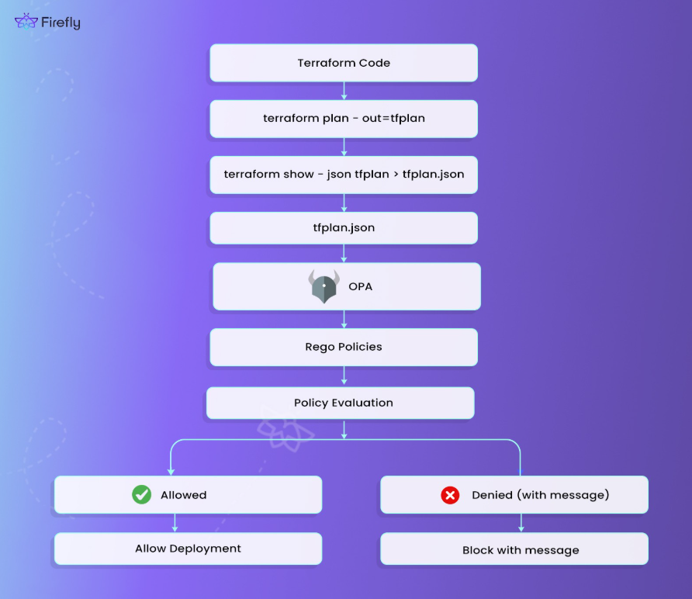
OPA – What & Why

Slide 79
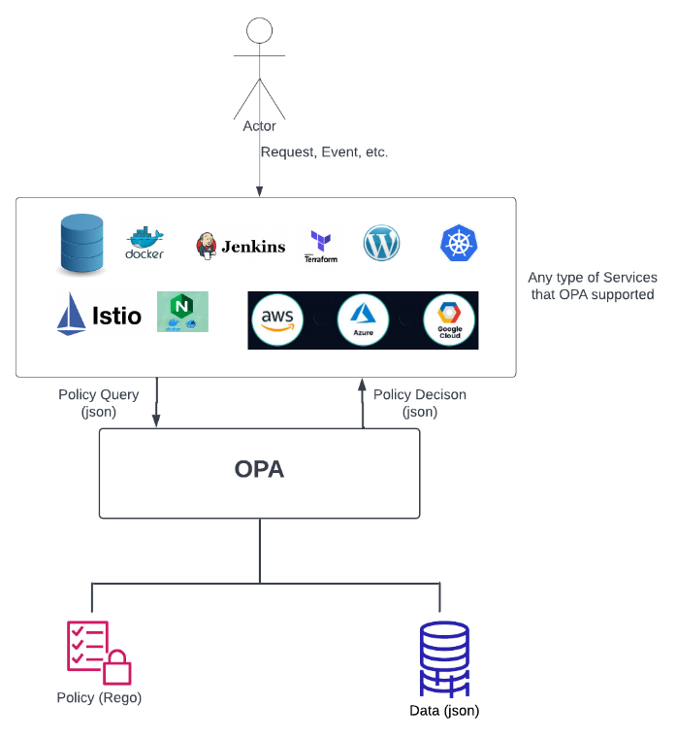

Slide 80
OPA – Core Concepts
Policy
Data
Input
Decision
Rego

Slide 81
OPA – Architecture
Policy engine evaluates input
Returns decisions
Runs as library or service
Central policy logic
Scalable and flexible

Slide 82
OPA – Use Cases
Kubernetes admission control
API authorization
IaC validation
Zero Trust security
Platform governance

Slide 83
OPA – When to Use
Shared policies across systems
Platform-level enforcement
Advanced governance
Large-scale environments

